Slide 1
DIA RWE Conference
Research-Grade Real World Data
on Long-Term and Post-Acute Care

Slide 2
Agenda
About PointClickCare
  Founder Story
  Key Facts
About Lighthouse by PointClickCare
  What is Lighthouse
  Why did we launch this initiative?
  How Lighthouse works – applications and use cases
  Data Samples
  Customer Engagement

Slide 3
Founder Story
PointClickCare is founder owned and operated by brothers
Mike Wessinger and Dave Wessinger in 2000
First cloud-based electronic health record (EHR) platform
in the senior care industry
SaaS model, a software delivery model that is the current standard across the senior care industry today
PointClickCare, the leading electronic health record (EHR) technology partner to North America’s long-term post-acute
care (LTPAC) and senior care industry

Slide 4
PointClickCare Story
Number of Senior Care Providers
Acquire Collective Medical
Acquire QuickMar
Enter Senior Living Market
Acquire in-Home
Care capabilities
Signed 2 of the
top 5 U.S. SNF chain Partners
Established

Slide 5
PointClickCare Story – Key Facts
1700
Mississauga | Toronto
Waterloo | PEI | Minneapolis
Cleveland | Rochester | Salt Lake City
+
      Founder Controlled
      JMI Equity (2011)
      Dragoneer Investment Group (2016)
      Hellman & Friedman (2020)
Employees
#1 Market Share
21
1.4
K+
M
Skilled Nursing | Senior Living
Senior Care Facilities in North America
Residents

Slide 6
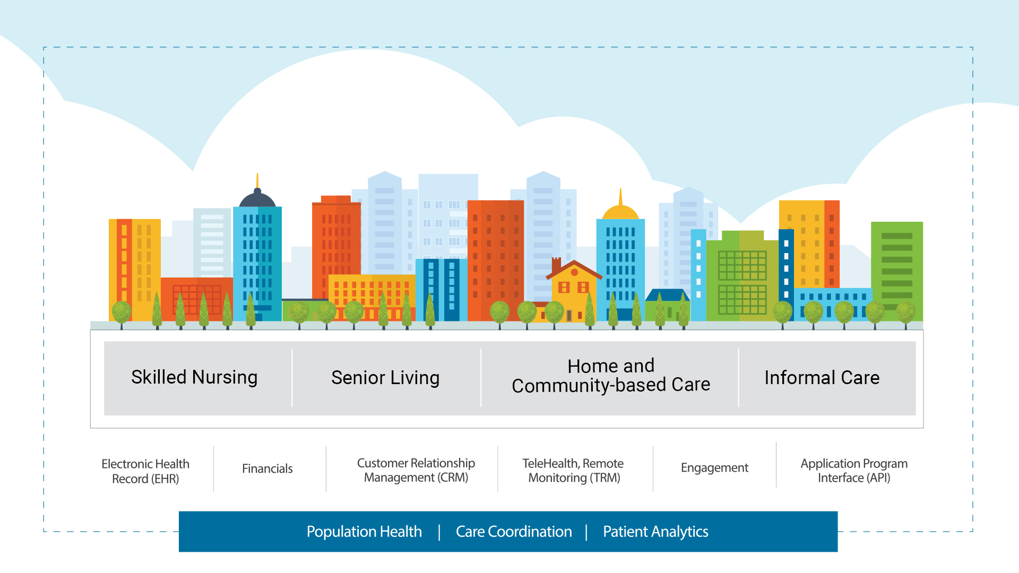
Cloud-based, Person-centered Health Information System
EHR and Revenue Cycle Management

Slide 7
Lighthouse by PointClickCare
PointClickCare is uniquely positioned to provide life sciences companies with insights about the aging population – the people and communities most susceptible to diseases. These insights have the potential to provide early warning, mitigate spread and find cures.
More and more information is being digitized, consolidated and analyzed in healthcare. To leverage this data, PointClickCare has launched its new Lighthouse project.
Brand promise.
To work in partnership with life sciences companies to significantly improve
outcomes in LTPAC and solve key drug development and communication
problems impacting vulnerable populations.
Advancing care.
Aggregating unique datasets, insights-driven outcomes
Front line disease management, with integrated assessments/screeners
Trial recruitment and support, care protocols, training and education, digital health, etc.
Partnerships that move the industry forward, fostering innovation

Slide 8

We capture a key part of the patient journey
< Transitional Care >
A
Hospital Basedv
21k+ (US)
< Transitional Care >
SNFs
Assisted Living
Ambulatory
Post-Acute Care
Home
< Transitional Care >

Slide 10
Claims Data vs. EMR sources
Comparison: Claims Data vs. EMR Data
 | Claims Data | LTPAC EMR Data
Scope of Data | Broad: Captures Data across Providers | Limited: Only Providers Using EMR
Scope of Patients | Insured Patients Only | All Patients including uninsured
Prescription Drugs | Prescription Orders/Refills | Includes Orders and Medication Administration
Non-Prescription Drugs | Not Present | Present
Data Richness | Limited: Diagnosis, Procedure, Medication | Rich: All Dx, Lab Results, Vitals, Assessments, Notes, ADT, Immunizations, Incidents

Slide 11
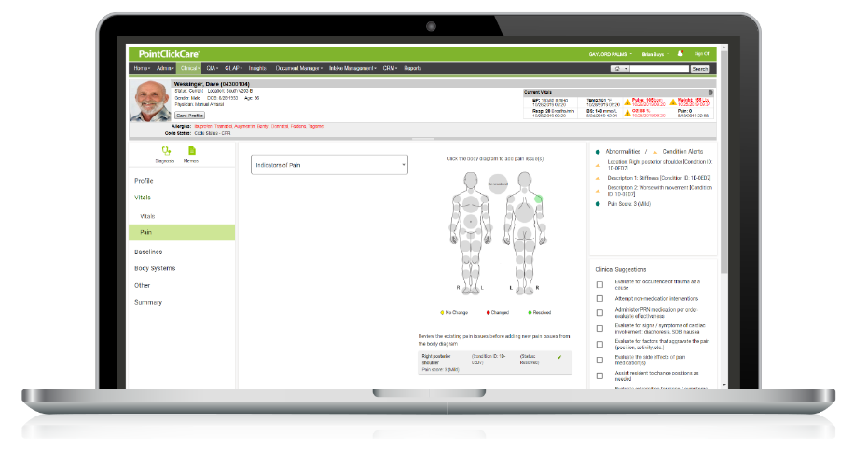
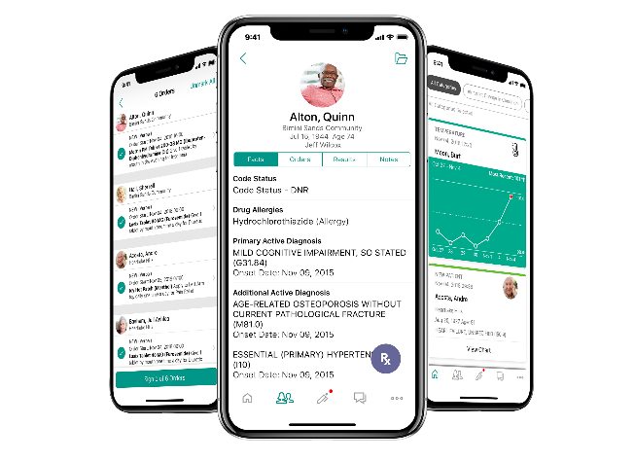
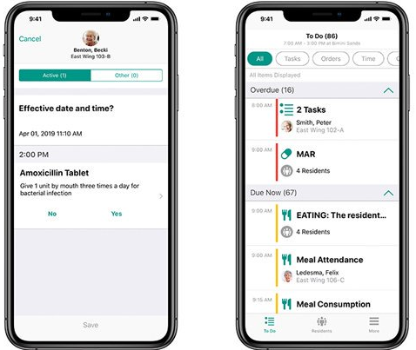
Empowered, Person-Centered Care
Intelligent, role-specific workspaces
Companion
Nursing Advantage
Practitioner Engagement
For Aides & Universal Caregivers
For Nursing Staff
For Providers
ADLs & support tasks
Medication management
Designed with input from Apple
Phase I: assessments & alerting
Dynamic, resident-centric assessments
Clinical suggestions & progress notes
Review resident’s chart
Manage encounters & orders
Receive alerts/updates

Slide 12
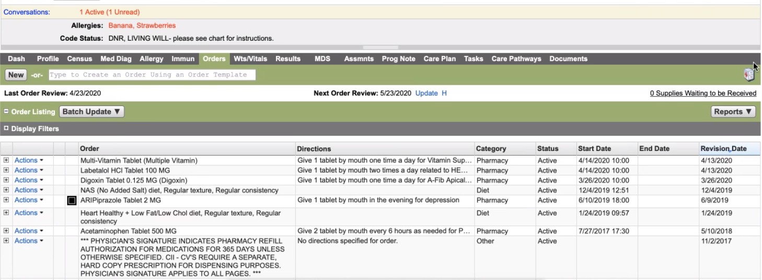

Slide 13
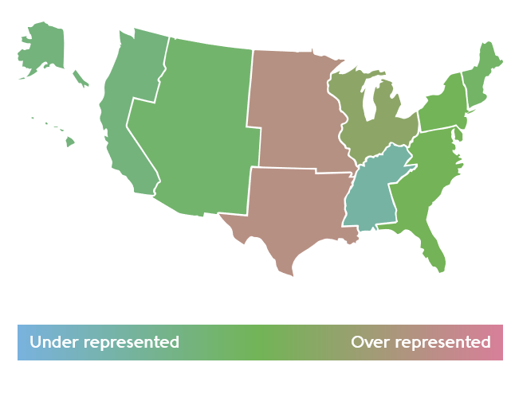
Representative Data
Region | Population | Census Population
East North Central | 19% | 15.0%
East South Central | 2.6% | 6.0%
Middle Atlantic | 13.1% | 13.2%
Mountain | 6% | 7.2%
New England | 4.1% | 4.7%
Pacific | 11.7% | 16.2%
South Atlantic | 19.7% | 19.4%
West North Central | 10.9% | 6.6%
West South Central | 13.1% | 7.8%
40.4%
Male
59.6%
Female
Ages | Population
0-17 | 3.9%
18-44 | 3.1%
45-64 | 13.6%
65+ | 79.4%
Source: PointClickCare, HealthVeritv

Slide 14
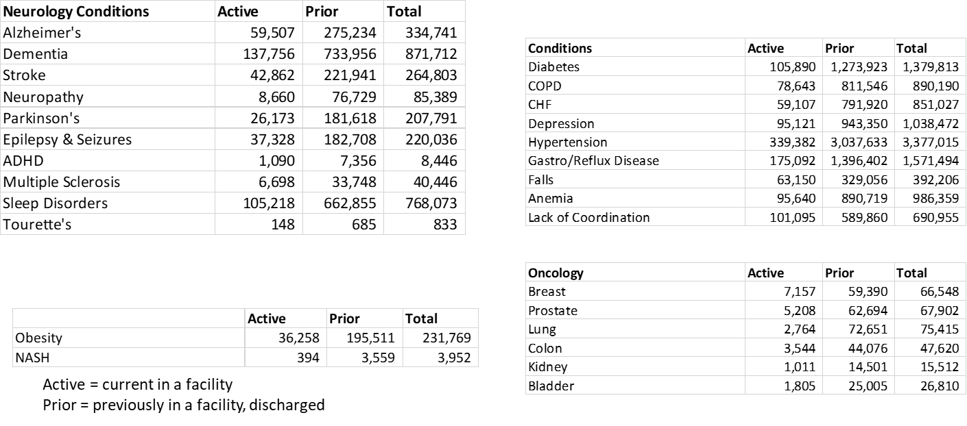
A sampling of patient counts

Slide 15




Applications and Use Cases
Clinical Dataset
Commercial Dataset
Development
& Trials
Real World Evidence
PV & Safety
Commercial Insights
Clinical Trial Design
& Optimization
Trial Recruitment
Drug Repurposing
Drug Candidate
Selection
Health Economics / Outcomes Research
Prospective Studies
Pragmatic Trials
Custom Research
/ Registry
Post-market
surveillance
Adverse Events
Epidemiology
Signal Detection
Drug Utilization
Market
Insights
Commercial Ops
Patient Journey
Brand Tracking
Market Access

Slide 16

Clinical Dataset
Treatment & Therapy
Encounters
Diagnosis & Co-morbidities
Claims/Cost
Outcomes & Biomarkers
MDS Assessments
Patient

Slide 17
A near census of the resident health activity
Reason & Treatment
Allergy
Census
Visit
Diagnosis
Immunization
Medication Orders & Administrations
Observations
Health Activity
Lab Results
Orders – Non- Drug
Health Maintenance
Care Profile
Family History
Outcome
Outcomes
MDS Assessments
Incident Reports
Re-admissions
Daily ADL Scores
BIMS
Falls
Example Measures: Activities for Daily Living (ADL) Score, Cognitive tests (eg, BIMS), Falls, Re-admissions

Slide 18
Our data provides a unique capability for ongoing research and insights
10+ years
of longitudinal data; 7x data volume of any other potential source
Unique
demographic,
higher number of
age-related morbidities (Dementia, Alzheimer's etc.)
< 30-day data recency
(vs. CMS @ 12 months)
Significantly longer average stay
Unique outcomes measures & biomarkers
More
clinical datapoints
per patient than CMS, Registry, Ambulatory or Acute EMR datasets
Patient Journey, COMS, Disease Management

Slide 19
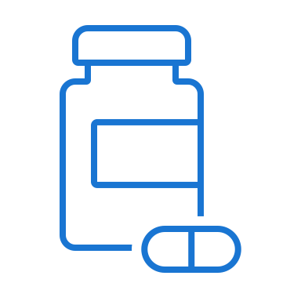
Commercial Dataset
Pharmacy
<Medication Order>
Medication
SNF, ALF Facility
HCP

Slide 20












Snapshot of Lighthouse Customers

Slide 21
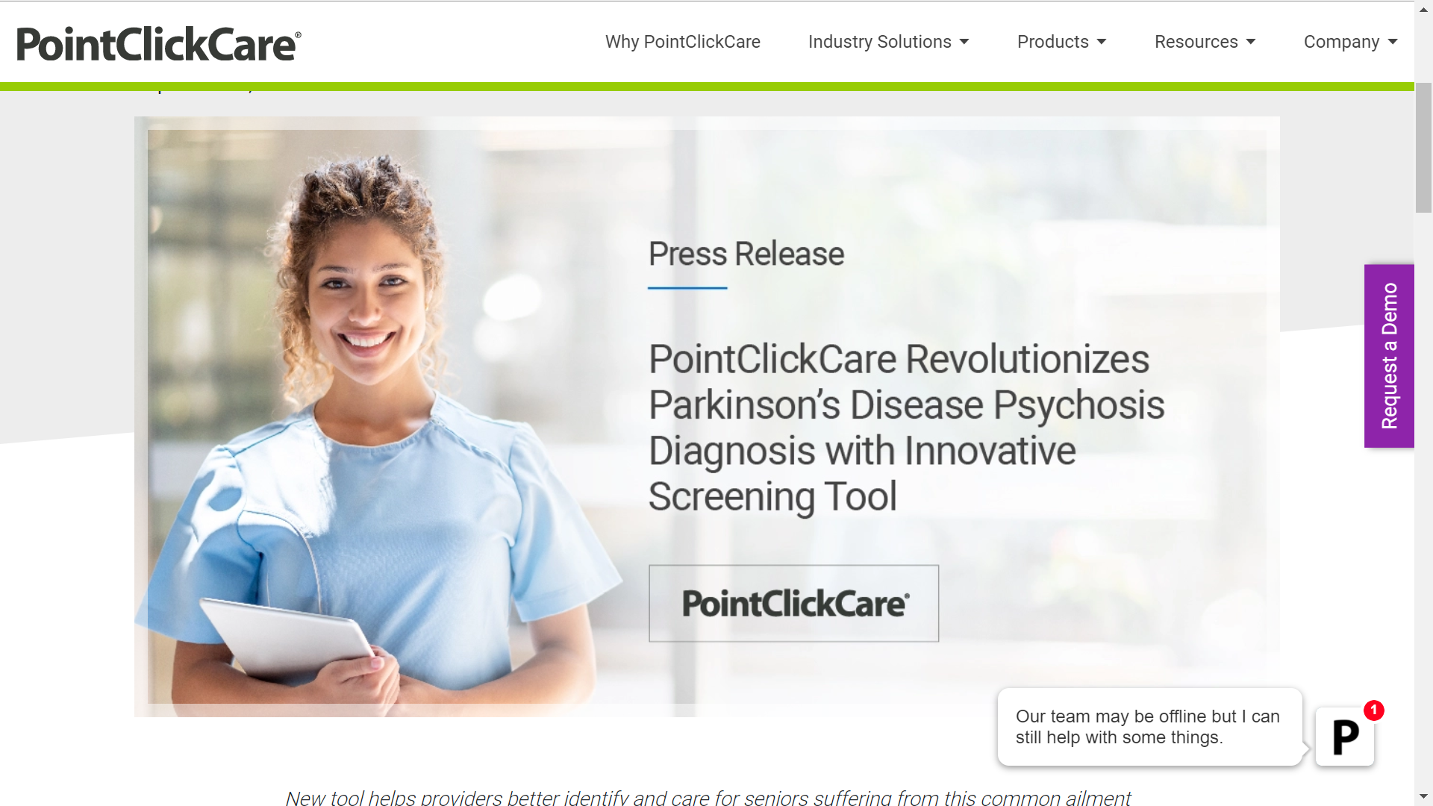
Disease Management; Prospective studies

Slide 22
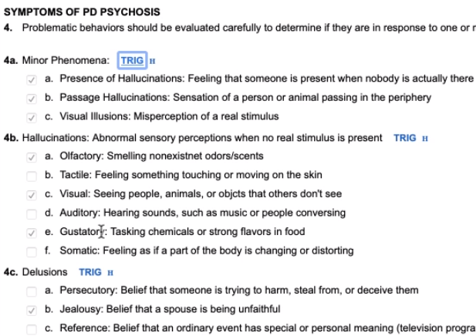
Prospective Data Capture in the EHR
Screening tools for disease-based assessments can be published within the EHR platform
Education and communications to ensure facilities are aware of it and how to use it
Enriched data capture for outcomes

Slide 23
Case Study #1
Small Pharma Manufacturer focused on PD and Dementia - ~$6B Market Cap
Mission to reduce inappropriate Anti-Psychotic us in PDP patient Population
Lacked visibility into downstream orders past the LTC Pharmacy
Lacked visibility to PD and PDP, PDD patients geographically
Required to support and provide incentive comp for LTC Sales Force
Desire for non-branded PDP screening tool (paper-based), to be on PCC platform as CSC
Have PDP PDD care planning tool (paper-based), to ideally go in PCC as Care Pathway
Solution – Lighthouse Commercial Dataset with Monthly delivery
Charter client for Commercial PowerBI Dashboards
New Visibility to HCP->Pharmacy->LTC facility for sales force
100% increase in PDP screener utilization
Future
Look at Dementia Patient population for new indication coming in 2021
Acquired Lighthouse Patient Dataset for PDP PDD, with Screener and PDP, PDD care plan data

Slide 24
Case Study #2
Top 50 Pharma – Global Pharma company
Clinical Study to Evaluate the impact of COPD patients switching from nebulized products to handheld products due to the COVID-19 pandemic
Outcomes measured were: Hospital re-admission rate, Rescue medication use, and COPD symptoms (Dyspnea)
Study is being completed by CRO (HEOR consultancy), and initial contract is with Precision
Solution – Lighthouse Clinical Dataset
Initial study results published; 3 new studies underway
Future
Lighthouse Commercial Dataset has also been purchased for facility, pharmacy and HCP insights

Slide 25
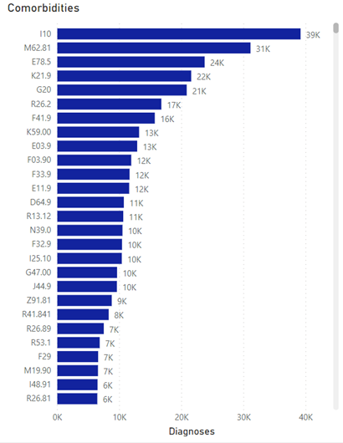
Comorbid Conditions

Slide 26
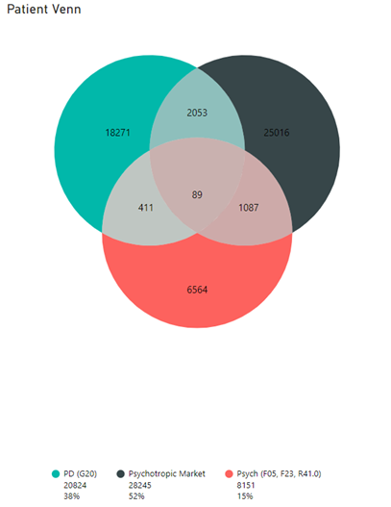
Cohort Analysis

Slide 27
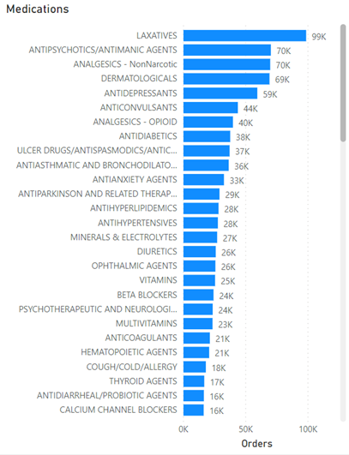
Medication Orders

Slide 28
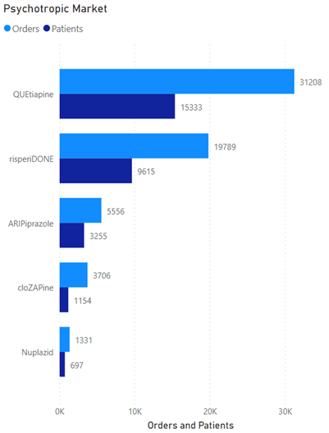
Patient Share

Slide 29
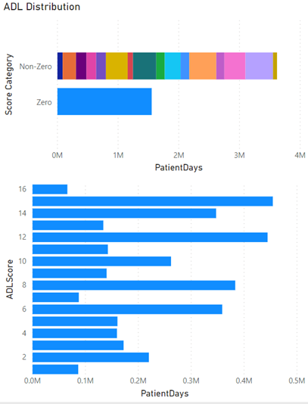
Activities for Daily Living Score Analysis

Slide 30
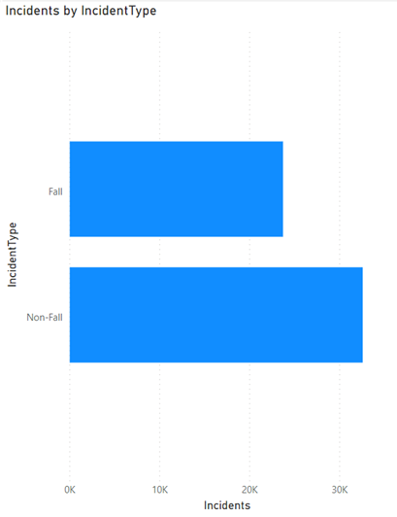
Incident Analysis

Slide 31
Case Study #2
Top 50 Pharma – Global Pharma company
Clinical Study to Evaluate the impact of COPD patients switching from nebulized products to handheld products due to the COVID-19 pandemic
Outcomes measured were: Hospital re-admission rate, Rescue medication use, and COPD symptoms (Dyspnea)
Study is being completed by CRO (HEOR consultancy), and initial contract is with Precision
Solution – Lighthouse Clinical Dataset
Initial study results published; 3 new studies underway
Future
Lighthouse Commercial Dataset has also been purchased for facility, pharmacy and HCP insights

Slide 32


Engagement
Syndicated Data provided per defined market
  annual subscription
  single-project use
Longitudinal, de-identified, patient EHR data linkable
via our partners below
Projected Data
Data science and research services
Prospective Patient Assessment and Screening tools

Slide 33
Thank you

