Slide 1

PresentMore
A Guide to Uploading Your Presentations

Slide 2
PresentMore
As a presenter, you will be able to upload your presentation materials to the site, where they will be reviewed by your program offering chair, approved and will then be waiting for you at the conference in your meeting room.
The conference will not allow presenters to bring their PowerPoint material straight to the meeting room, you must upload beforehand.
We are only accepting PowerPoint file (.pptx or .ppt) for session presentations or PDF files for poster sessions.

Slide 3
Naming Your Presentation File
Each presentation is unique, and is associated with you, the presenter, and the session/room that you are assigned to.
When you login to PresentMore if do not see all the presentations you should, contact Maureen Lamplugh – Maureen.Lamplugh@diaglobal.org.
How to name your presentation file:
File Naming Criteria:
Keep your file names very short, do not use "illegal" characters, slashes, commas, etc.
IE: Smith_Joe_session or presentation title_v1 (Last name, first name, your session or presentation title and version)
If you are combining presentations for a session into one PPT, please name as: Combined_session__v1
Contact Maureen Lamplugh – Maureen.Lamplugh@diaglobal.org if you have questions.

Slide 4
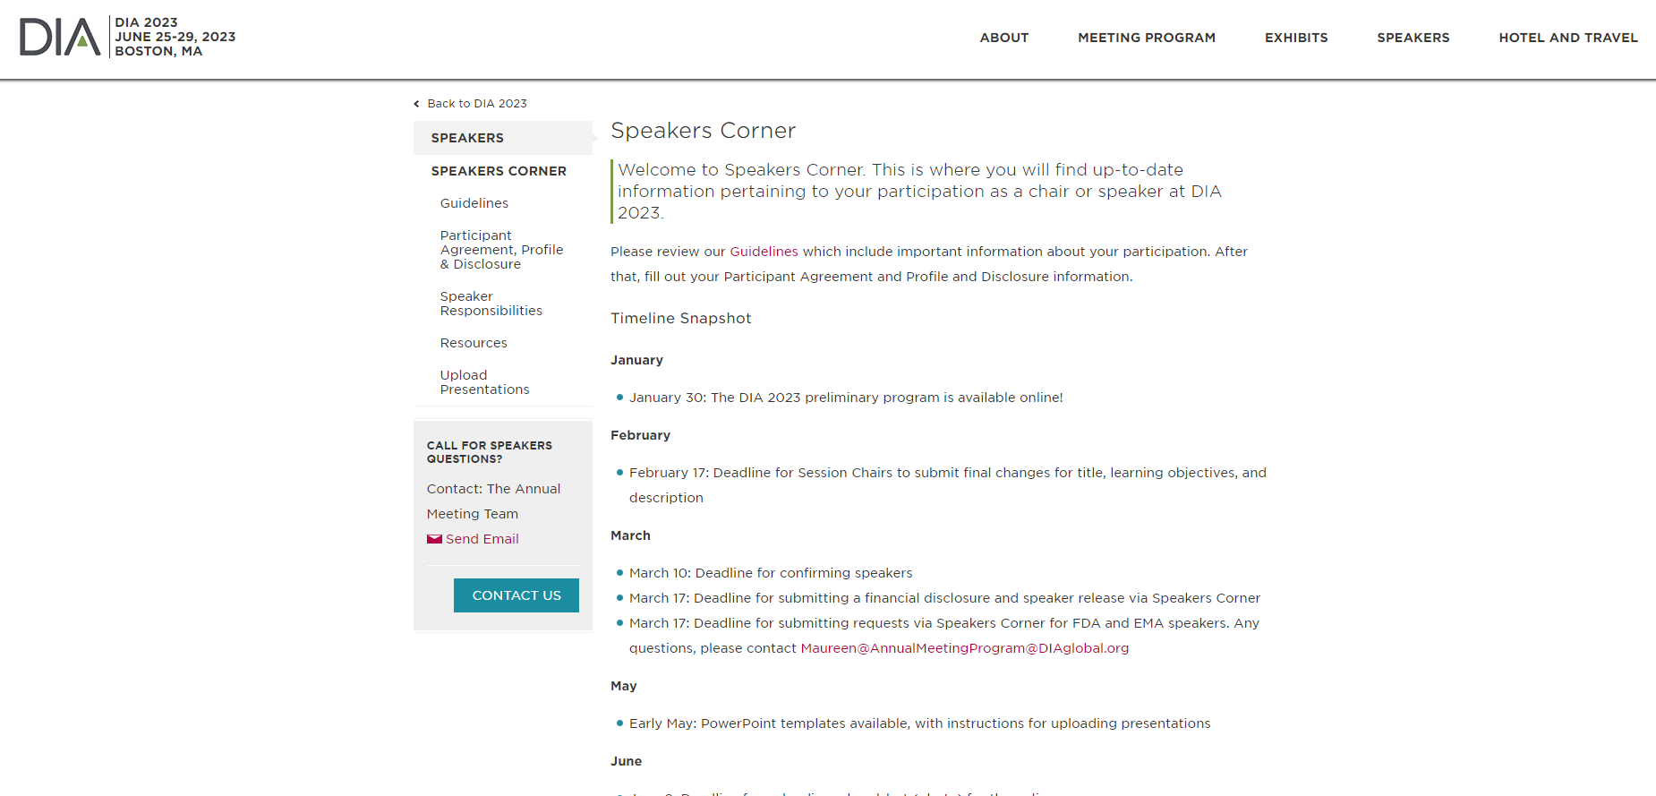
Logging in
Go to Speakers Corner on the DIA 2023 webpage. Visit here.
On the left navigation, click on "Upload Presentation"

Slide 5
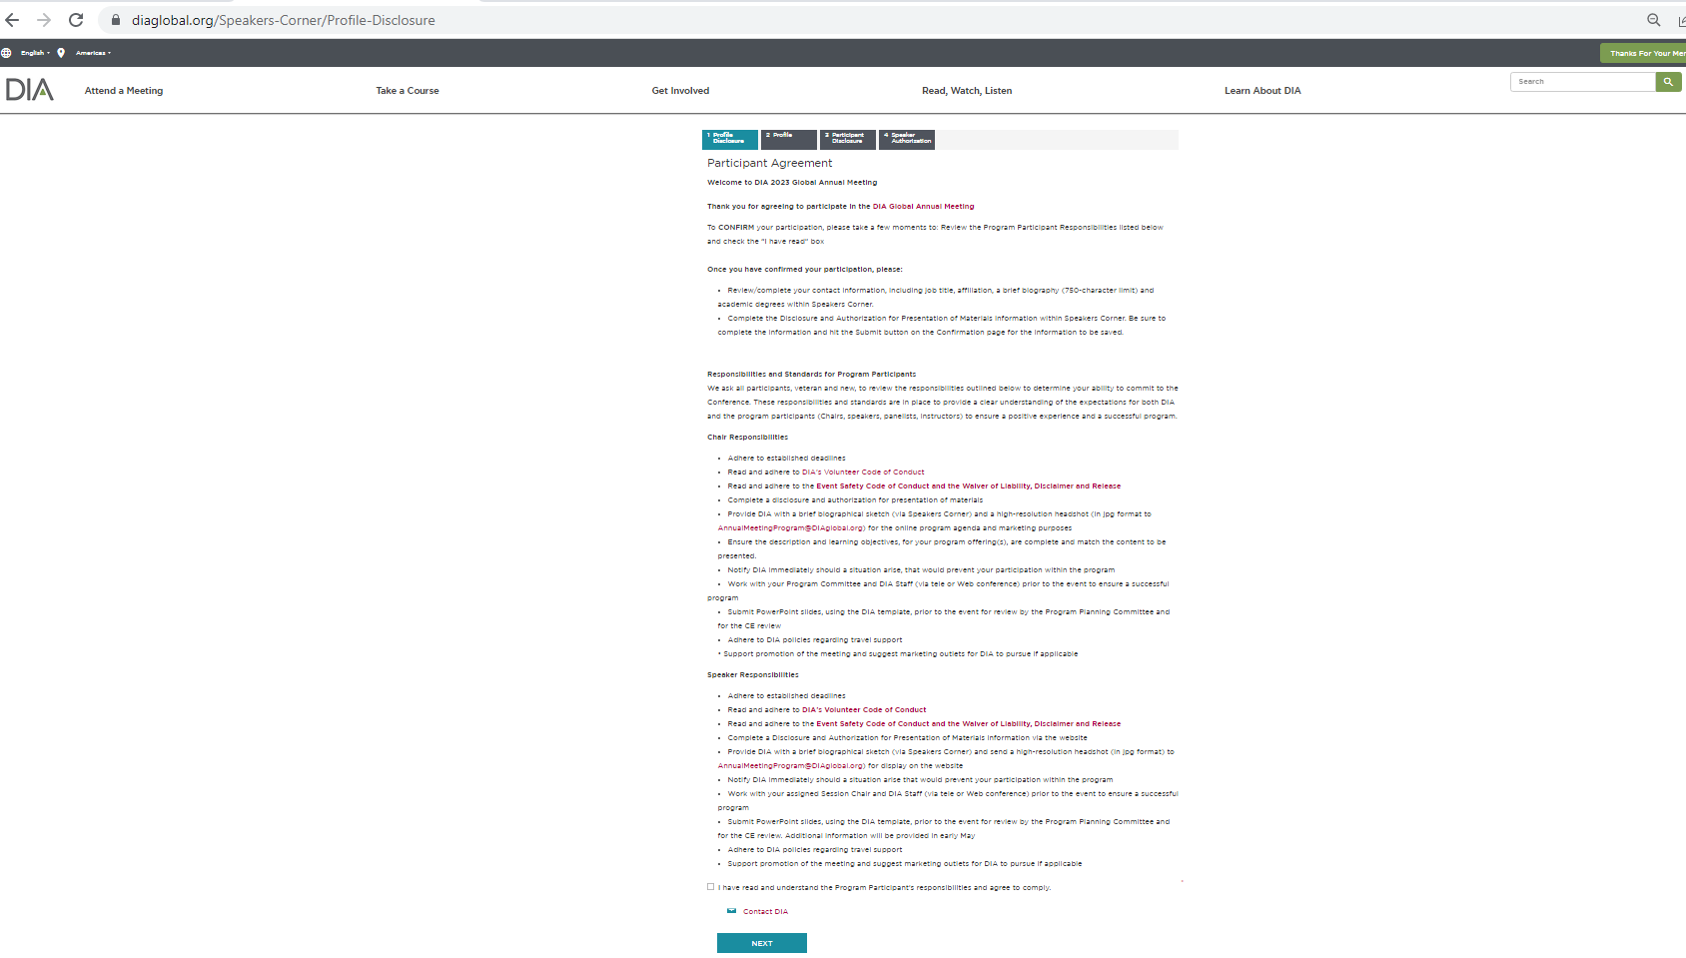
If you have NOT yet completed a disclosure, you will be taken to the disclosure page, you must complete your disclosure to continue on to Upload Presentations.

Slide 6
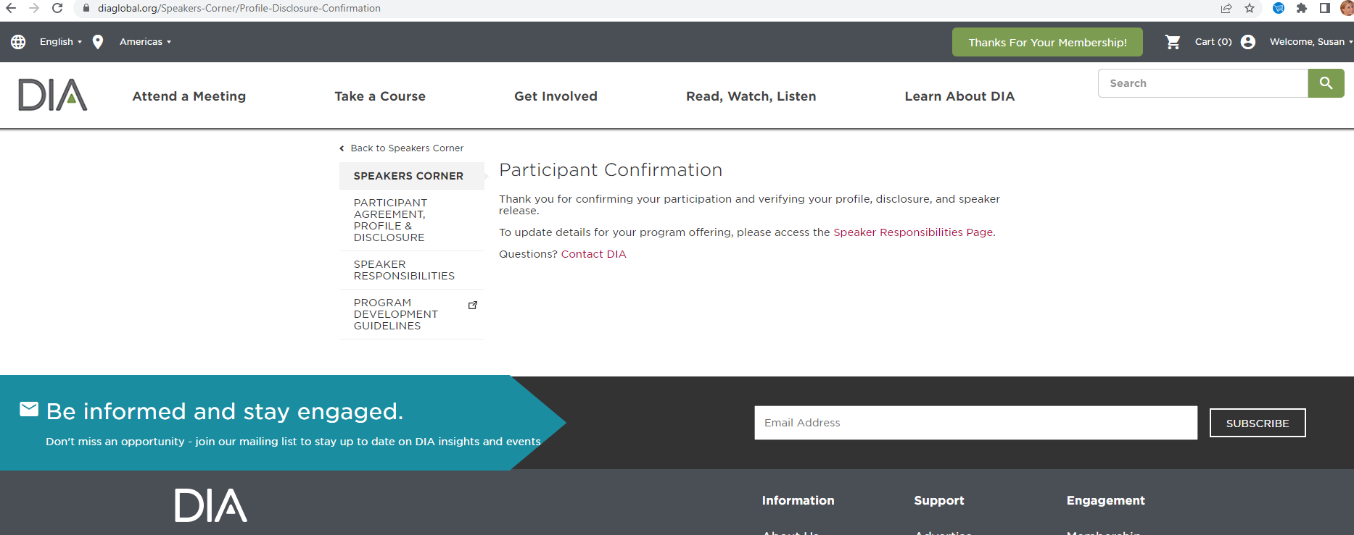
Once you submit your disclosure, you need to go back to Speakers Corner

Slide 7
Logging in
Once back to the Speakers Corner Page
On the left navigation, click on "Upload Presentation"

Slide 8
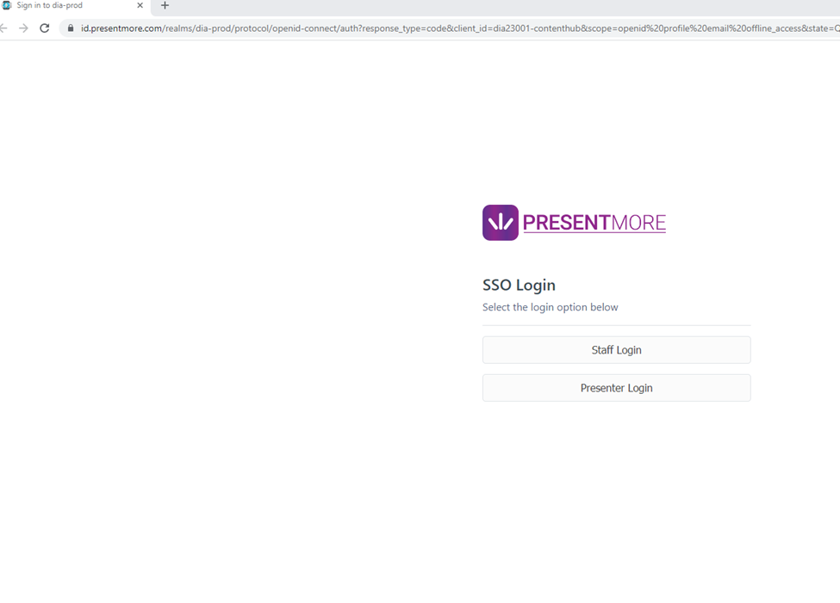

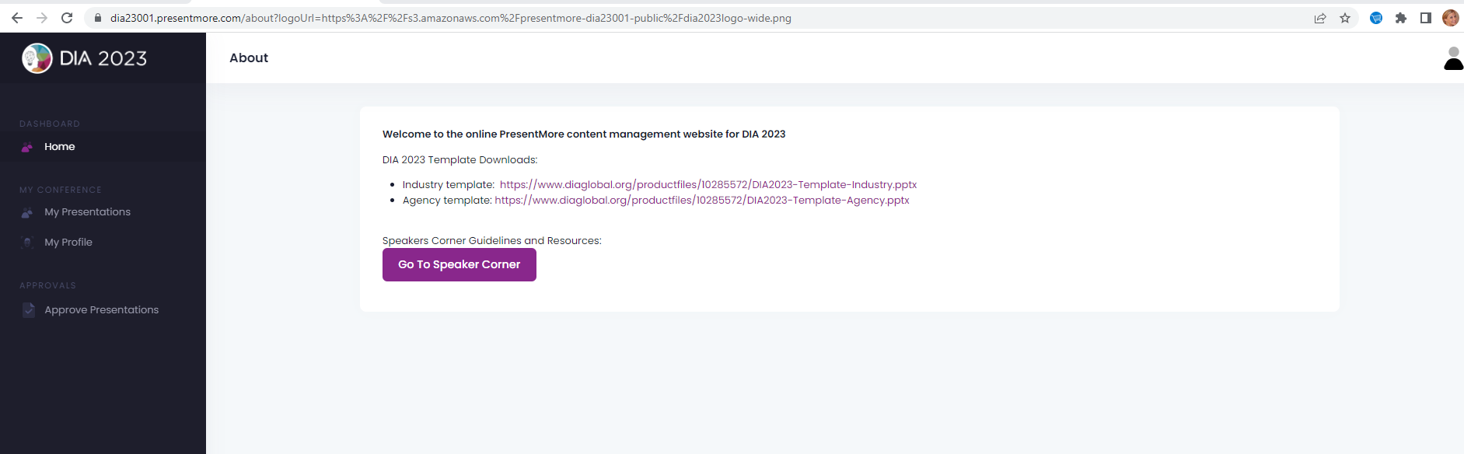

Logging in
Choose Presenter Login
Click on My Presentations in the left side navigation bar

Slide 9
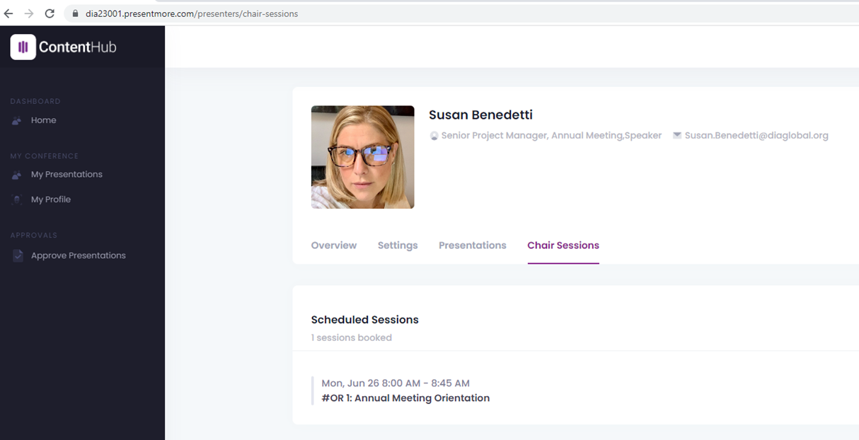

5. If you are a speaker click on Presentations, if you are a chair click on Chair Sessions
6. Click on the session or presentation you wish to upload a presentation for

Slide 10
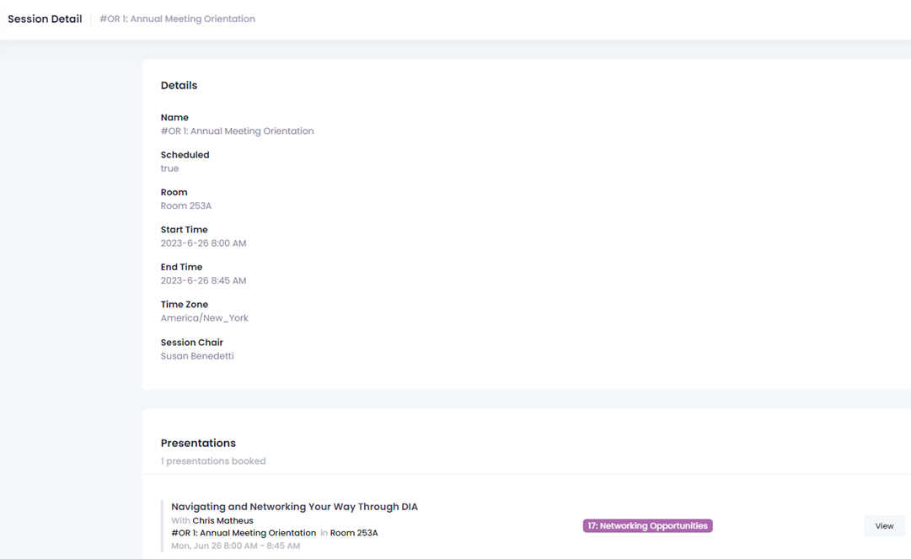
Click on the Presentation title you wish to upload slides for

Slide 11
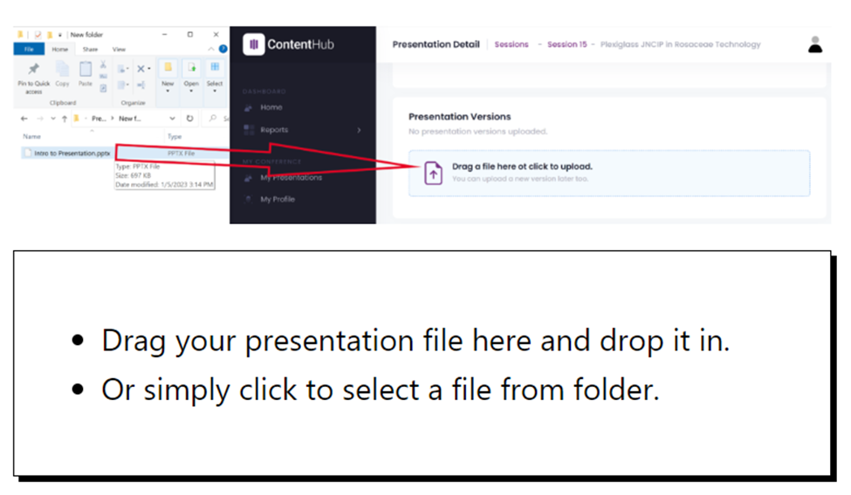
Uploading via Drag and Drop or Click
You can either drag a file into the specified area on the page, or click it into select the file you’d like to upload.

Slide 12
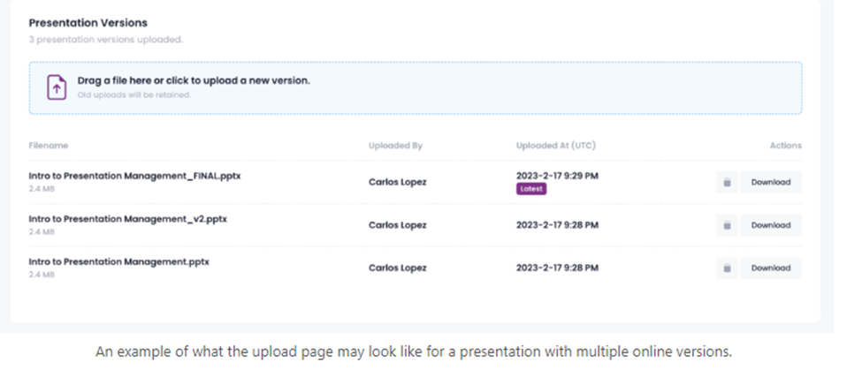
Uploading
PresentMore allows you to upload multiple files to your Presentation, but only the most recent upload is considered your actual file. When you upload a new file, it will be labeled as “Latest”.
You can delete the latest version, and the second latest becomes the latest.
Click the Trash icon to delete a file. When you do that, the file with the next newest date stamp will become the Latest – and will be the file pushed to the room.

Slide 13
Uploading
Once your file has been uploaded it has been received by PresentMore and is ready for presenting! If for any reason you’d like to download your file to verify you uploaded the correct one click the “Download” button and the file will download to your system’s typical download location.
If you make any edits to this file be sure to re-upload it to PresentMore, making this new version the latest!

