Slide 2
Disclaimer
The views and opinions expressed in the following PowerPoint slides are those of the individual presenter and should not be attributed to Drug Information Association, Inc. (“DIA”), its directors, officers, employees, volunteers, members, chapters, councils, Special Interest Area Communities or affiliates, or any organisation with which the presenter is employed or affiliated.
These PowerPoint slides are the intellectual property of the individual presenter and are protected under the copyright laws of the United States of America and other countries. Used by permission. All rights reserved. Drug Information Association, DIA and DIA logo are registered trademarks or trademarks of Drug Information Association Inc. All other trademarks are the property of their respective owners.

Slide 13
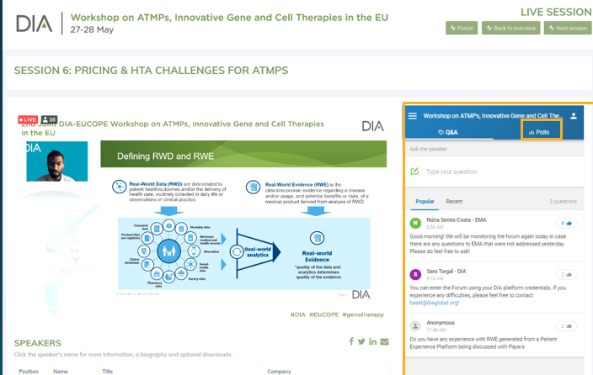
Sli.do!
During your sessions DIA will use Sli.do as the main interactive tool, which will further engage the audience during presentation discussions with polls, Q&A and transitions between speakers/sessions. We will provide an in-depth look at how we will incorporate it during the Technical Rehearsal & Orientation. See screenshot below of how it looks during the Live virtual conference.
Send your Sli.do Polls and/or Questions (if applicable to your session) via email to the DIA Europe Programme Team with Poll/Question and details of when you want to launch it.
Please remove this slide from your final presentation

