Slide 1
Development & The US FDA Approval of Generic Drugs
May 18, 2011 | Beijing, China
SHAO Jun, Ph.D.

Slide 2
Agenda
About Generic Drugs
Business Strategy for Generic Drugs
Generic Drug Product Development
Generic Drug Approval Process
Question-Based Review
Summary

Slide 3
What are Generic Drugs
US FDA’s Definition:
A generic drug is identical, or bioequivalent to a brand name drug in dosage form, safety, strength, route of administration, quality, performance characteristics, and intended use.

Slide 4
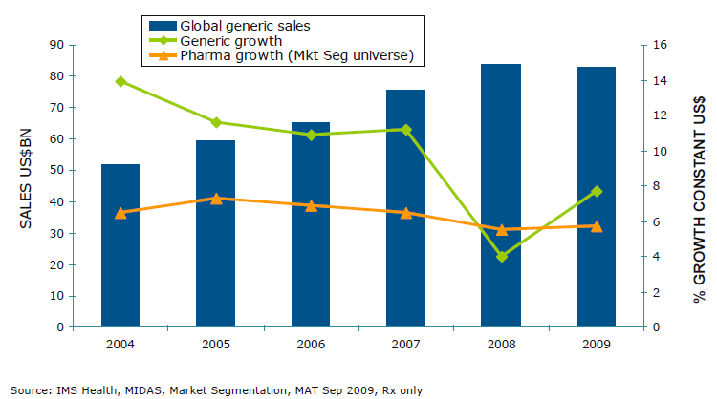
Generic Share of Market
The global generics market reaches $8.3bn while growth recovers climbing to 7.7%.

Slide 5
Generic Pharma in U.S.
Generic Prescriptions
Generic medicines account for 69% of all prescriptions dispensed in the United States, yet only 16% of all dollars spent on prescriptions. (source: IMS Health)
Generic pharmaceutical products are used to fill nearly 2.6 billion prescriptions every year.

Slide 6
How Did Generic Drugs Emerge in US Market?
Drug Price Competition and Patent Term Restoration Act of 1984 – Waxman-Hatch Act
Created a framework for patent term extensions and nonpatent exclusivity periods for brand name drug products
Created an Abbreviated mechanism for approval of generic copies of all drugs originally approved after 1962, by stating that pre-clinical and clinical testing does not have to be repeated for generics.
Provided for pre-patent expiration testing (Bolar provision) and generic drug exclusivity

Slide 7
What are the Basic Requirements?
➢ Contain the same API as the innovator drug (inactive ingredient may vary)
➢ Be identical in strength, dosage form, and route of administration to RLD
➢ Have the same use indications as RLD
➢ be bioequivalent to RLD
➢ meet the same batch requirements for identity, strength, purity and quality
➢ be manufactured under the same strict standards of FDA’s GMP regulations required for innovator products

Slide 8
Basic Requirements for a Generic Drug
Regulatory & Legal
Labeling
CM&C/Microbiology
Bioequivalence

Slide 9
When can a Generic Drug be Marketed?
Regulatory & Legal Requirements:
➢ After patent & exclusivity protection ends, or
➢ Patent owner waives its rights, and
➢ FDA requirements are met.

Slide 10
Regulatory & Legal Requirements
Orange Book: • Approved Drug Products with Therapeutic Equivalence Evaluations • List of drug products approved on the basis of safety and effectiveness by the US FDA under the Federal Food, Drug, and Cosmetic Act.
Patents: • All approved patent numbers and expiration dates • Patents that claim the active ingredients or ingredients • Drug product patents which include formulation/composition patents • Use patents for a particular approved indication or method of using the product
Code (Two-Letter) for Existing Generics: • First letter: if it is bioequivalent; Second letter: Additional information, e.g., dosage forms • Equivalence rating to the innovator product; • If the first letter is A, no biostudy needed for approval (i.e. AA, AN, AO, AP, AT-no problem, AB-demonstrated) - substitutable
• If the first letter is B, NOT to be therapeutically equivalent to other products (BC, BD, BE, BN, BP, BR, BS, BT, BX, B*).

Slide 11
Regulatory & Legal Requirements
A Certification from ANDA sponsor: • Paragraph I: that such patent information has not been filed;
• Paragraph II: that such patent has expired; • Paragraph III: of the date on which such patent will expire, or

Slide 12
Regulatory & Legal Requirements
A Certification from ANDA sponsor: • Paragraph IV: that such patent is invalid or will not be infringed by the manufacturer, use, or sale of the new drug for which the application is submitted.
♦Challenge the listing of the patent; ♦File a statement that the application for use is not claimed in the listed patent; ♦MUST notify the patent holder of the submission of the ANDA. If the patent hold files an infringement suit within 45 days of the ANDA notification, FDA approval for the generic drug is automatically postponed for 30 months.

Slide 13
Product Insert Label
“Same” as brand name labeling
May delete portions of labeling protected by patent or exclusivity
May differ in excipients, PK data and how supplied
Should use the newest version available
Should use the label from FDA website <drugs@FDA>, rather than DailyMed
Side-by-side comparison is required! Sponsor’s label in SPL format may be provided.

Slide 14
Chemistry, Manufacture & Control
Components and composition
Manufacturing and controls
Batch formulation and records
Description of facilities
Specs and tests
Packaging
Stability
Microbiology

Slide 15
CM&C: Product Development
Decide what product to pursue
Find source of API (DMF w/US FDA), excipients & packaging materials
3. Develop a unit formula
Develop manufacturing process and scale up
Develop, verify and validate analytical methods
Set product specification-Control Strategy
Manufacture submission batches
Conduct BE study or waive BE study
Prepare CTD/eCTD and file with US FDA

Slide 16
What are difference in NDA vs. ANDA Review Process?
Brand Name Drug Generic Drug
NDA Requirements ANDA Requirements
1. Chemistry 1. Chemistry
2. Manufacturing 2. Manufacturing
3. Controls 3. Controls
4. Labeling 4. Labeling
5. Testing & Release 5. Testing & Release
6. Animal Studies
7. Clinical Studies 6. Bioequivalence
8. Bioavailability

Slide 17
What are difference in NDA vs. ANDA Review Process?
NDA Requirements ANDA Requirements
Stability data Stability data
Three batches One batch
6 M Accelerated 3 M Accelerated and
12 M Storage Long-term storage commitment
Approval Time Approval Time
6 M for priority 6 M cycle*
12 M for standard**
*Median approval times for original ANDA is 18.3 months, 17.3 months and 16.3 months for years of 2002, 2003 and 2004 respectively.
**User fee: 1.5MM.

Slide 18
Develop A Drug Product
Physical
Physical
Chemical
API Properties
Excipient Properties
Chemical
Mechanical
Mechanical
Components & Amounts
Process
Process Steps
Formulation
Small-scale Manufacture
Scale-up
Validation & Commercialization

Slide 19
CM&C: Quality by Design
The short version…
QbD is a systematic, science-driven, knowledge and risk based approach to developing, manufacturing and controlling pharmaceutical products throughout their lifecycle.

Slide 20
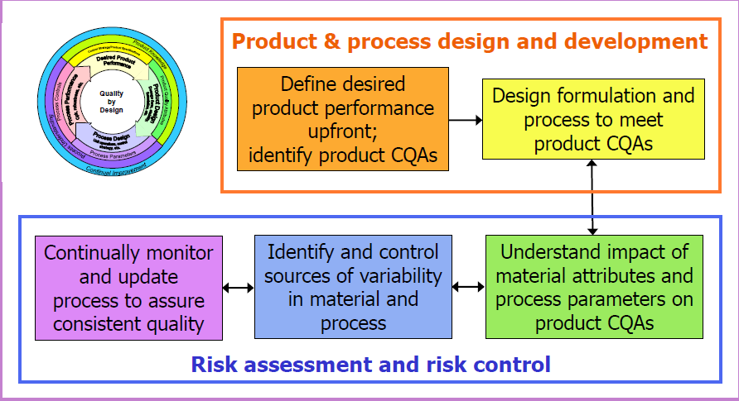
CM&C: Quality by Design

Slide 21
CM&C: Linkage between Q8, Q9 & Q10
Process Monitoring/
Continuous Verification
Process
R&D
Production
Formulation
R&D
ICH Q8(R) Pharmaceutical Dev
ICH Q9 Quality Risk Mngmnt
ICH Q10 Pharmaceutical Quality System

Slide 22
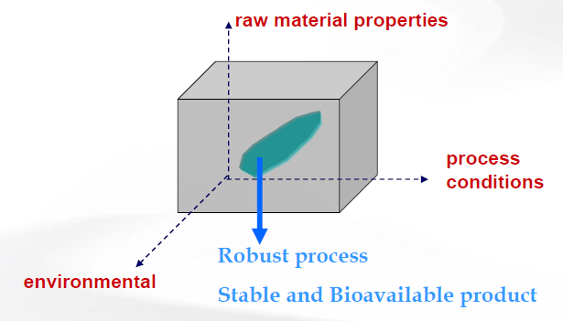
QbD: Design Space
Multidimensional combination and interaction of input variables (e.g., material attributes) and process parameters demonstrated to provide assurance of quality

Slide 23
QbD: CMA & CPP
➢Critical Material Attribute (CMA)
A physical, chemical, biological or microbiological property or characteristic of a material that should be within an appropriate limit, range, or distribution to ensure the desired product quality
➢Critical Process Parameter (CPP)
A process parameter whose variability has an impact on a critical quality attribute and therefore should be monitored or controlled to ensure the process produces the desired quality

Slide 24
CMAs and CPPs: an Example
Process Parameters
Speed
Forces
Depth of fill
Punch penetration depth
Room Moisture
Feeder
Hopper
Identity
Assay
Purity/Impurity
Dissolution
(Disintegration)
Mixing
Compression
Material Attributes
After Compression
Tablet weight
Breaking strength
Thickness
UDU
Solid fraction
Friability
Appearance
Material Attributes
Before Compression
Blend uniformity
Particle size
Density
Moisture
Flow Properties

Slide 25
Bioequivalence
A generic drug is considered to be bioequivalent to the RLD if:
• the rate and extent of absorption do not show a significant difference from the listed drug, or
• the extent of absorption does not show a significant difference and any difference in rate is intentional or not medically significant

Slide 26
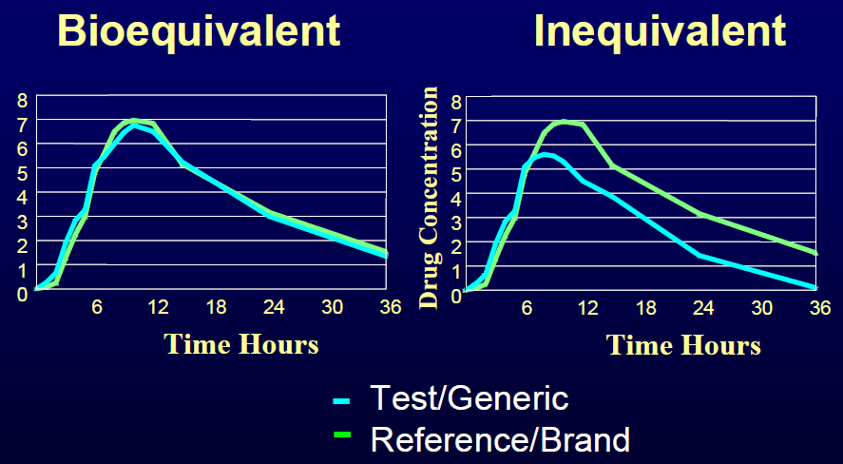
What is Bioequivalence?

Slide 27
Bioequivalence Criteria (Two One-sided Tests Procedure)
AUC and Cmax
90% Confidence Intervals (CI) must fit between 80%-125%
Test (T) is not significantly less than reference
Reference (R) is not significantly less than test
Significant difference is 20% (α = 0.05 significance level)
T/R = 80/100 = 80%
R/T = 80% (all data expressed as T/R so this becomes 100/80 = 125%)

Slide 28
Waivers of In Vivo Study Requirements
➢Criteria (21 CFR 320.22)
In vivo bioequivalence is self-evident
Parenteral solutions
Inhalational anesthetics
Topical (skin) solution
Oral solution
Different proportional strength of product with demonstrated BE

Slide 29
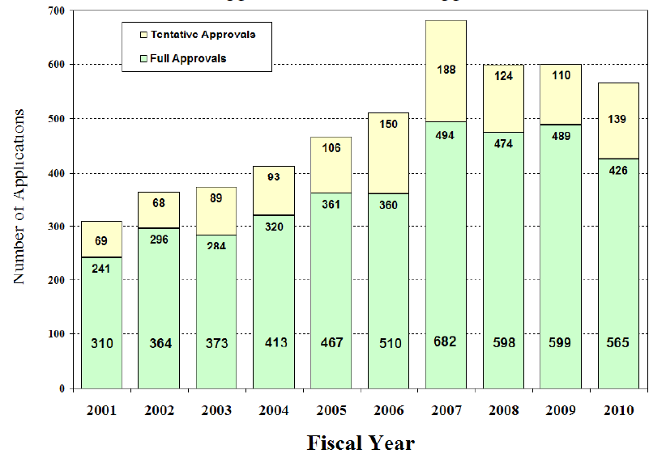
ANDA Approvals
Source: FDA in GPhA Annual Technical Meeting 2010

Slide 30
Generic Drug Review Process
Sponsor
ANDA
ANDA#
Application Quality Review
Submission Validation
No
Refuse to Receive Letter
Acceptable & Complete
Yes
Request for Plant Inspection
Chemistry & Micro Review
Labeling Review
Bioequivalence Review
Deficiency Letters
Deficiency Letters
No
PreApproval
Inspection Results
OK?
Chem/Micro
OK?
Labeling
OK?
Bioequivalence
OK?
No
No
Yes
Yes
Yes
Yes
Approval Withheld until Results Satisfactory

Slide 31
ANDA: Question-based Review
Question-based Review (QbR) is a general framework for a science and risk-based assessment of product quality
QbR contains the important scientific and regulatory review questions
ANDA sponsors answer the questions
OGD reviewers evaluate the responses to the questions

Slide 32
Advantages of QbR
➢Questions guide reviewers
Prepare a consistent and comprehensive evaluation of the ANDA
Assess critical formulation & manufacturing variables
➢ Questions guide industry
Recognize issues OGD generally considers critical
Direct industry toward QbD
➢ Questions inform readers of the review
How QbD was used in the ANDA
Provide the basis for a risk assessment

Slide 33
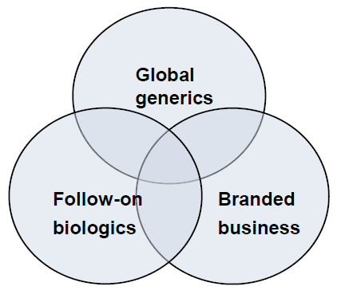
Future Generic Industry
Strong Management
Control manufacture cost
Globalization
Diversified product pipeline
Biologics- vague and expensive

Slide 34
Summary
Generic industry has been well established and strictly regulated in the US.
The bar to enter the circle becomes higher in terms of product quality & GPM compliance.
Question-based Review has been used by FDA for generic drug approval & will be required soon.
Generic drug development is a good opportunity for China Pharma to enter global pharmaceutical competition.

Slide 35
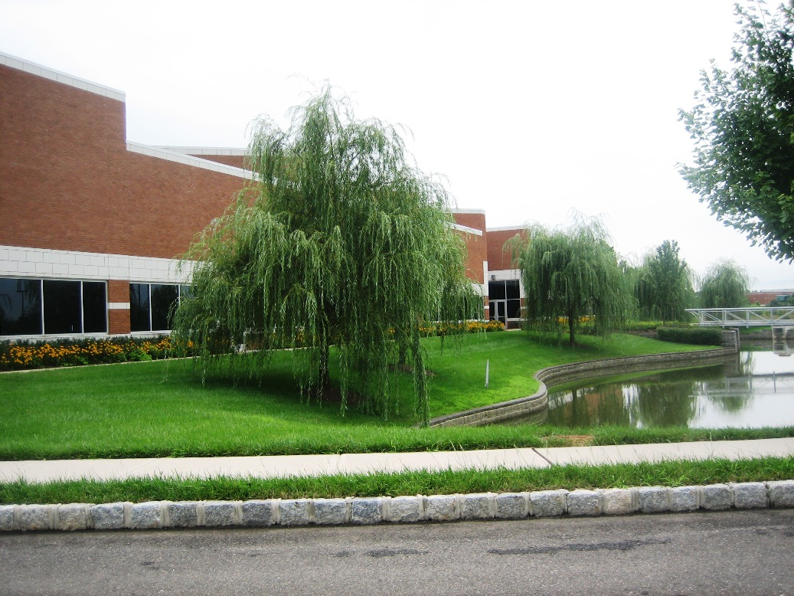
Home of eVenus
Thank you!

