Slide 1
Pharmaceutical Reference Standards: Overview and Role in Global Harmonization
3rd DIA China Annual Meeting
Beijing, China, 16 - 18 May, 2011
Matthew Borer, Ph.D., Advisor

Slide 2
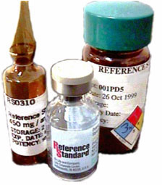

What is a Pharmaceutical
Reference Standard?
A highly purified sample of a particular compound that has been characterized so that an accurate content can be stated
Used as the basis for quantitative and qualitative testing
if 100%
SAMPLE
then 90%

Slide 3
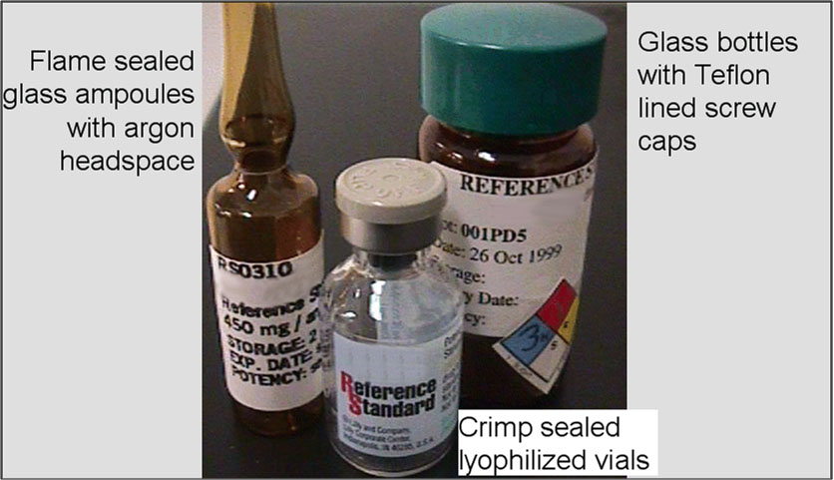
Reference Standard Materials

Slide 4
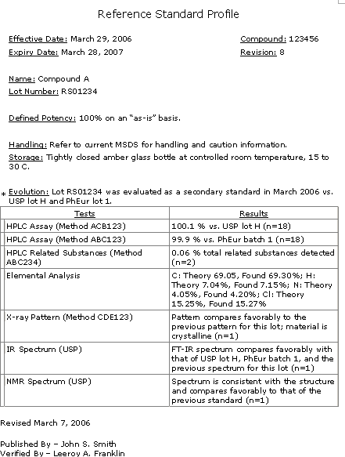

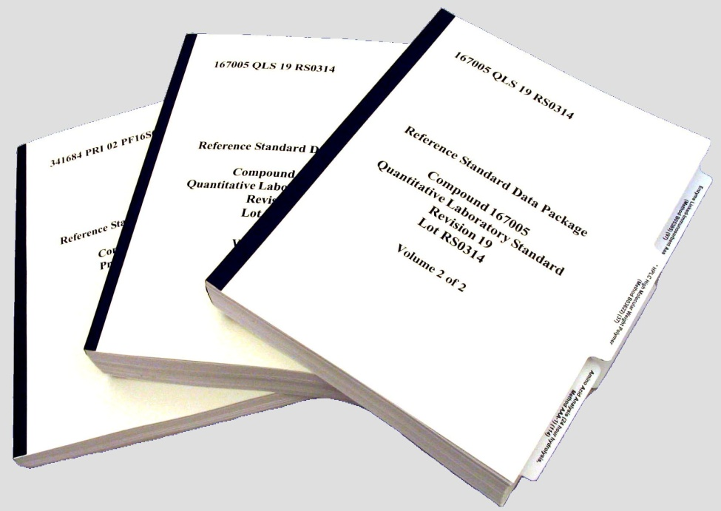
Reference Standard Information
Certificate
Protocol
Data
Package

Slide 5
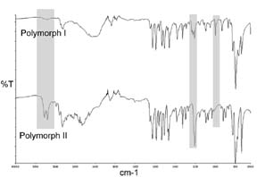
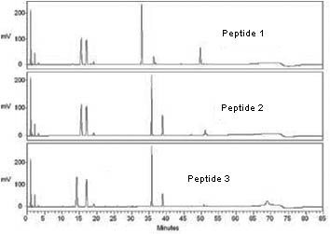
Reference Standard Uses
Quantitative calibration
Identity comparison
Test of system suitability
Peak marker
Fingerprinting
Visual comparison

Slide 6
Types of Reference Standards
Reference Standard
Company
Reference Standard
Laboratory-based
Reference Standard
Official
Reference Standard
Primary
Reference Standard
Primary
Reference Standard
Secondary
Reference Standard
Other
Reference Standard
Notes:
Local reference standards are out of the scope of the presentation.

Slide 7
Reference Standard
Role in Pharmaceutical
Testing

Slide 8
The Role of Reference Standards in a Pharmaceutical Control System
Reference Standards are developed as part of the analytical control strategy for each drug product
Each reference standard has a control strategy of its own
Reference Standards play a central role in assuring the quality of medicines for patients during cGMP testing and release activities

Slide 9
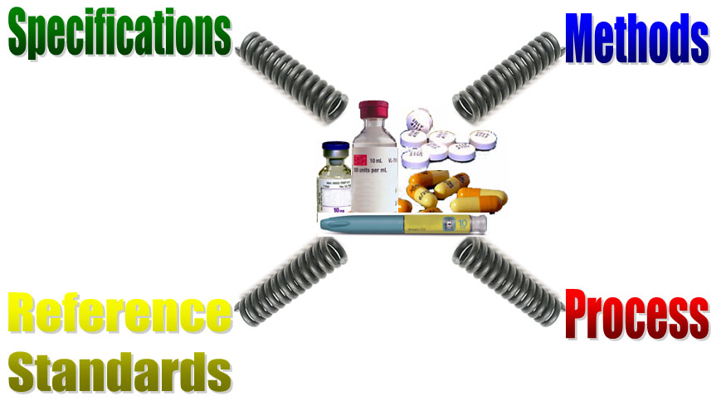
Simplified Product Control Strategy
What the
measurement
means…
How to
measure…
What to
measure…
When to
measure…
Basis of the measurement…

Slide 10
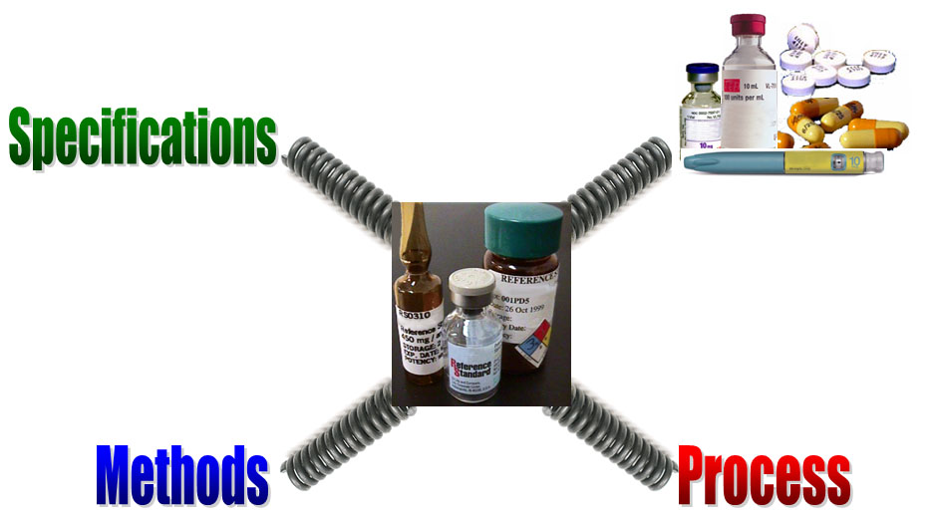
Reference Standard Control Strategy

Slide 11
Regulations Governing RS Operations
Food and Drug Administration (FDA)
    CFR Title 21 – Food and Drugs GMP, 211.194(c), 211.160(b)(1) and 299.5(c)
    ICH Guidelines Q7, Q6B
    Various FDA Guidance Documents
    FDA regulatory observations (Warning Letters, 483’s)
    United States Pharmacopeia
European Agency for the Evaluation of Medicinal Products (EMEA)
    EU GMP 32, Annex 18 (transcription of ICH Q7)
    EU Quality Guideline 32 (regulatory submission requirements)
    ICH Guidelines Q7, Q6B
    European Pharmacopoeia
Japan Ministry of Health Labor and Welfare (MHLW)
    Japan Pharmacopoeia Technical Information (JPTI) 1995, section 2
    ICH Guidelines Q7, Q6B
    Japan Pharmacopoeia
Notes:
You would think that there would be a multitude of regulations governing reference standards, but this IS NOT THE CASE.
Title 21 – Food and Drugs Good Manufacturing Practice
CFR 210: GMPs for Processing, Packing, Holding of Drugs
CFR 211: GMPs for Finished Pharmaceuticals

Slide 12
Additional Sources of Guidance
ISO Guidelines 31, 32, 34
WHO Technical Report Series (TRS) 885, 902, and 908
Published Warning Letter Citations
Benchmarking of Findings at Other Firms
Audit Near Misses
Internal QA/QC Audits
Notes:
KEY POINT: Can you demonstrate that your business is in CONTROL.

Slide 13
Reference Standard vs Drug Product
Reference Standard
  Intended use – laboratory control
  Limited regulatory requirements
  Limited registration commitment
  Closed system of users
  Infrequent manufacturing
  Overprotective packaging
  Overprotective storage
  Sterility typically unimportant
  Documentation is critical!
  s I S p Q : Strength and Identity are most critical
GMP for Human Consumption
  Intended use – human dosing
  Extensive regulatory requirements
  Extensive registration commitment
  Open system of patients
  Routine manufacturing
  Packaging optimized for cost
  Storage optimized for convenience
  Sterility typically vital
  Documentation is critical!
  S i s P Q : Safety and Purity are most critical
Safety, Identity, Strength, Purity, Quality

Slide 14
Summary
Reference Standards are an integral part of a pharmaceutical product control strategy
Reference Standards have their own unique control strategy
There are some external regulations and more external guidance associated with pharmaceutical reference standards
Reference Standards are not drugs (have a different intended use) and thus have unique attributes
Reference Standard Quality Systems must be designed with regulations, guidance, unique attributes, and intended use in mind

Slide 15
Reference Standard
Quality Systems

Slide 16
Lilly RS Quality System
Global Quality Standard – Reference Standards
Local Procedures
Establishment and Maintenance
Acquisition and Management of Materials and Components
Production Records
Finishing Operations
Inventory Management
Storage Facility Requirements
Processing, Dispensing, Transferring, and Shipping
Complaints and Withdrawals
Quality Unit Responsibilities

Slide 17
Example:
Reference Standard Characterization
Reference standard characterization must be customized to support its specific intended use
ICH Q3a, IV
  Reference standards used in the analytical procedures for control of impurities should be evaluated and characterized according to their intended uses.
WHO, Annex 3, Technical Report Number 885,3
  It is necessary to consider all data obtained from testing the material by a wide variety of analytical methods. When taken as a whole, this will ensure that the substance is suitable for its intended use. The extent of the analyses required depends on the purpose(s) for which the chemical reference substance is to be employed, and may involve a number of independent laboratories.
ISO 34, 4.1.1
  It should be recognized that a reference material needs to be characterized mainly to the level of accuracy required for its intended purpose

Slide 18
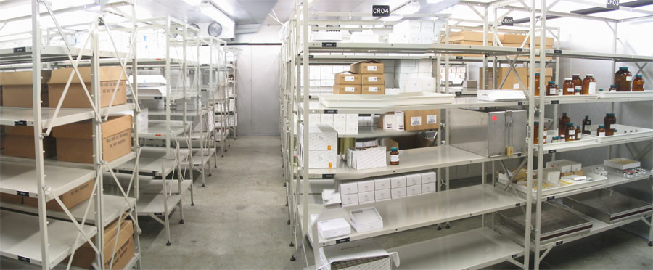
Example:
Inventory Management
Material receipt
Inventory segregation
  Active, Inactive, Hold
Material moves
Cycle counting
Disaster recovery
Removal from inventory

Slide 19
Global
Harmonization

Slide 20
Example: Legal Basis for
United States Pharmacopeia
According to the FD&C Act Section 501 and 21CFR299(c), a drug marketed in the United States must comply with compendial standards
FD&C Act SEC. 501. [21 U.S.C. 351]
A drug or device shall be deemed to be adulterated
(b) If it purports to be or is represented as a drug the name of which is recognized in an official compendium, and its strength differs from, or its quality or purity falls below, the standards set forth in such compendium. Such determination as to strength, quality, or purity shall be made in accordance with the tests or methods of assay set forth in such compendium,…
§299.5 Drugs; compendial name.
(c) A statement that a drug defined in an official compendium differs in strength, quality, or purity from the standard of strength, quality, or purity set forth for such drug in an official compendium shall show all the respects in which such drug so differs, and the extent of each such difference.

Slide 21
Verified in Guidance to Inspectors
Compliance Program Guidance Manual
for FDA Staff: Drug Manufacturing Inspections Program 7356.002
  PART III – INSPECTIONAL
  C. System Inspection Coverage
  LABORATORY CONTROL SYSTEM
For each of the following, the firm should have written and approved procedures and documentation resulting therefrom…
  - reference standards; source, purity and assay, and tests to establish equivalency to current official reference standards as appropriate

Slide 22
Verified by 483 Observations
Eastman Chemical Company
  Review of procedures for handling Reference Standards showed that Triacetin working standards are not compared to or qualified against the USP Triacetin RS. Current and draft SOPs for handling reference standards in general do not clearly indicate what tests or methods of qualification are to be used for each standard material, or specify how the expiry/re-certification date is established; instead it allows any chemist discretion in these matters.

Slide 23
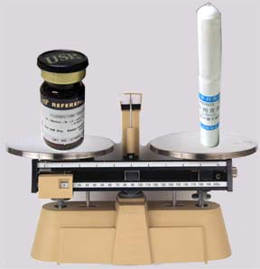

Reference Standard
Harmonization Goals
The same dose of medicine for every patient around the world
No difference in property values of a Reference Standard only due to measurement variability

Slide 24
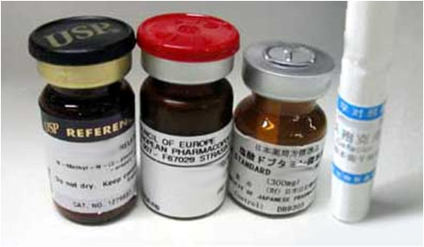
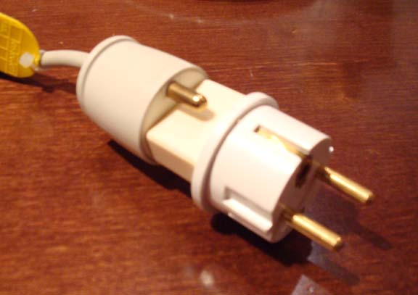
The Challenge for a Global Manufacturer
How to maintain equivalency with multiple national standards?

Slide 25
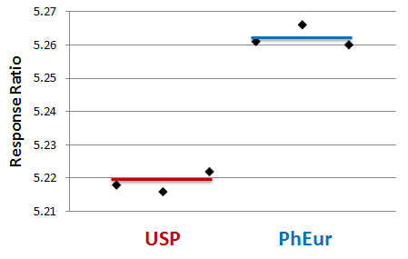
Example: Small Molecule API
Student t-test results in a P-value of 3.5x10⁻⁵, rejecting the null hypothesis that the mean values are equivalent
Comparing ratio of the solution concentration to the peak area on a single HPLC setup
0.84%

Slide 26
Example: Peptide Drug Product
Shifts in control chart correlate with new compendial reference standards

Slide 27
Ways to Demonstrate Equivalency
Comparative Assay
Establish a Secondary RS using the Compendial RS as a Primary RS per the ICH Q7 definition
Official RS
Standard
Secondary RS
Sample
Assigned Value

Slide 28
Ways to Demonstrate Equivalency
Mass Balance
Assign the in-house RS by another means (e.g., mass balance) and show that this assignment is equivalent to comparative assay results versus the compendial standard(s) (e.g,. mass balance is within the 95% confidence interval)
Official RS
Standard
Assigned Value
Secondary RS
Sample
Mass
Balance
Secondary RS
equivalent

Slide 29
Why Establish an In-house RS?
Pre-compendial support
  Compendial RSs are not available during development and early commercialization
Global supply chain
  An in-house RS can be shown equivalent to more than one Official RS
Reliable supply
  It is unacceptable to halt manufacturing waiting for an Official RS to be re-supplied
Control of frequency of batch replacement
  Official RS batches might be replaced frequently which reduces long-term consistency
Usage rate
  Agencies typically cannot supply the volume of RSs required by the pharmaceutical industry
Intended use
  An in-house RS can be shown compatible with intended uses beyond monographs
Site-to-site consistency
  When global manufacturing sites use the same RS, there is more assurance or consistency
Cost
  In-house RSs are less expensive to maintain, especially when there are multiple Official standards

Slide 30
Future Challenges
The difficulties associated with characterization of biomolecule reference standards make harmonization of multiple compendial reference standards a challenge
No way to fully define the Potency via physiochemical testing, so the Primary RS defines biological activity
but
The Primary RS has no basis for comparison, so monitoring for change in Potency is hampered
and
Bioassay methods are typically highly variable, making it difficult to measure small changes

Slide 31
Conclusions
Reference Standards are an essential part of cGMP pharmaceutical manufacturing
Reference Standards are not drugs and thus have a unique intended use and unique attributes
Reference Standard Quality Systems must be designed with regulations, guidance, unique attributes, and intended use in mind
It is a challenge to maintain multiple regional official standards that are equivalent, especially for biomolecules
Global compendial agencies and manufacturers should work together to maintain equivalency

